Slide 1
Data Base manipulation using PHP
Chapter 6

Slide 2
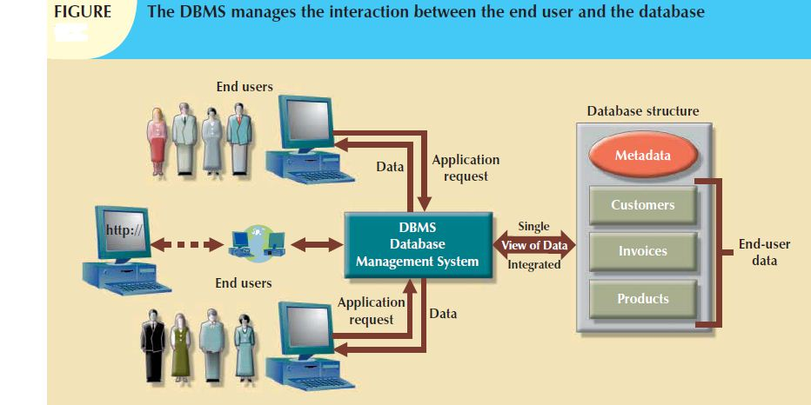
Review on Database terms
1
Database: is a collection of related data
Database Management System (DBMS): A software package/ system to facilitate the creation and maintenance of a computerized database.
Software to process queries
+
Software to access data

Slide 3
A Relational DataBase Management System (RDBMS)
Enables you to implement a database with tables, columns and indexes.
Guarantees the Referential Integrity between rows of various tables.
Updates the indexes automatically.
Interprets an SQL query and combines information from various tables

Slide 4
RDBMS Terminology:
Database: A database is a collection of tables, with related data.
Table: A table is a matrix with data
Column: One column (data element) contains data of one and the same kind, to represent one property of an entity
Row: A row (= tuple, entry or record) is a group of related data, to represent one instance of an entity
Redundancy: Storing data twice, redundantly to make the system faster.
Primary Key: A primary key is unique. A key value can not occur twice in one table. With a key, you can find at most one row.
Foreign Key: A foreign key is the linking pin between two tables
Constraints: rules set over database elements

Slide 5
Introduction to MySQL
MySQL is a RDBMS
Is an open-source software
Use standard form of SQL data language
supports large databases, up to 50 million rows or more in a table
The MySQL command line monitor Creating database tables Queries
Notes:
MySQL supports large databases, up to 50 million rows or more in a table. The default file size limit for a table is 4GB, but you can increase this (if your operating system can handle it) to a theoretical limit of 8 million terabytes (TB).
•

Slide 6
Basic queries
CREATE: create databases and tables
  CREATE TABLE tableName(columnName Datatype constraint, …. );
SELECT: select table rows based on certain conditions
  SELECT columnName, columnName… FROM tableName WHRER condition;
DELETE: delete one or more rows of a table
  DELETE FROM tableName WHERE condition;
INSERT: insert a new row in a table
  INSERT INTO tableName(column list) VALUES (column values);
UPDATE: update rows in a table
  UPDATE tableName SET columnName = NewValues;
ALTER: alter the structure of a table
  ALTER TABLE tableName ADD columnBame dataType;
  ALTER TABLE tableName DROP columnName;
  ALTER TABLE tableName MODIFY columnName Datatype [NULL value] [DEFAULT value];
  ALTER TABLE tableName CHANGE old_columnName new_columnName datatype;
  ALTER TABLE tableName RENAME TO new_tableName;

Slide 7
Administrative MySQL Command:
USE Databasename: This will be used to select a particular database in MySQL work area.
SHOW DATABASES: Lists the databases that are accessible by the MySQL DBMS.
SHOW TABLES: Shows the tables in the database once a database has been selected with the use command.
SHOW COLUMNS FROM tablename: Shows the attributes, types of attributes, key information, whether NULL is permitted, defaults, and other information for a table.
SHOW INDEX FROM tablename: Presents the details of all indexes on the table, including the PRIMARY KEY.
SHOW TABLE STATUS LIKE tablename\G: Reports details of the MySQL DBMS performance and statistics.

Slide 8
PHP and MySQL functions
Connecting to a Database
Making a query
Using results of a query
Freeing resources
closing the connection

Slide 9
Connecting to a Database
$servername=“servername:port";
$username=“mysql_user_name“;
$password=“mysql_password";
$dbname=“database_name“;
$con = mysqli_connect($servername, $username, $password, $dbname);
Opens a new connection MySQL server
$servername can be either a host name or an IP address
the default is the string "localhost:3306"
username is a string for the user name
password is a string for the password
dbname is the name of the database to connect with
returns FALSE on failure

Slide 10
Example PHP for DB connection
<?php
function connect_db($dbname){
$con = mysqli_connect("localhost:3306", "root", "", $dbname);
if(mysqli_connect_errno()){
echo "Connection failed: " . mysqli_connect_error();
}
return $con;
}
?>

Slide 11
Making a query (1. SELECT)
$query="SELECT SID, StudName, age, sex FROM student";
$result=mysqli_query($con, $query);
This task involve preparing a query and submitting it to the database engine for retrieval
$con is the connection string
query is a string for the MySQL query
It makes a select query
Don't end the query with a semi-colon
Return value is a resource identifier or FALSE if the query is SELECT or SHOW

Slide 12
Making a query (2. INSERT and UPDATE)
for these queries a resource is not returned
TRUE is returned on success
FALSE is returned on failure
Syntax rules to follow:
  The SQL query must be quoted in PHP
  String values inside the SQL query must be quoted
  Numeric values must not be quoted
  The word NULL must not be quoted
$sql1 = "INSERT INTO student (StudName, age, sex, SID) VALUES ('$studname', '$age', '$sex', '$sid')";
$sql2= “UPDATE student SET StudName='$studname', age='$age', sex='$sex‘ WHERE SID='$sid‘ ";

Slide 13
Using the query result
Involves two subsequent tasks
  Identify the number of rows affected by the query
  Fetch the data from the database server
  In this step, we can iterate through the result and display the record in a certain format. Example: in a tabular format
$row=mysqli_num_rows($result);//number of rows
$row_record=mysqli_fetch_row()
/*each call returns the next row as an indexed array where result is a resource returned from a call to mysqli_query (FALSE if no more rows)*/
$row_record=mysqli_fetch_assoc($result);//record set
/*as in mysql_fetch_row but next row is returned as an associative array*/
$row_record=mysqli_fetch_array(result)
/*combines mysqli_fetch_row, mysqli_fetch_assoc
returns row information as both an associative array and an indexed array*/

Slide 14
Example PHP for DB query (SELECT)
<?php
function viewData($dbname){
$dbname= $dbname;
$con = connect_db($dbname);
$sql = "SELECT SID, StudName, age, sex FROM student";
$result=mysqli_query($con, $sql);
if(mysqli_num_rows($result)>0){
echo "<table border='1'><th>ID</th><th>NAME</th><th>AGE</th><th>SEX</th>";
while($row=mysqli_fetch_assoc($result)){
echo "<tr><td>".$row["SID"]."</td><td>".$row["StudName"]."</td><td>".$row["age"]."</td><td>".$row["sex"]."</td></tr>";
}
echo "</table>";
}
else{
echo "no record found";
}
}
?>

Slide 15
Freeing query resources
mysqli_free_result($result)
free memory associated with the given resource
called result (after a select query).
Not necessary except for large result sets
Done automatically when script exits.

Slide 16
closing the connection
mysqli_close($con)
close the database connection associated with the given database link, ($con).

Slide 17
Error handling
mysqli_connect_errno()
Returns the last error code number from the last call to mysqli_connect
An error code value for the last call to mysqli_connect, if it failed.
zero means no error occurred
mysqli_connect_error
Returns a string description of the last connect error
NULL is returned if no error occurred.

Slide 18
Other functions
mysqli_real_escape_string($con, $ escapeString);
This function is used to create a legal SQL string that you can use in an SQL statement.
The given string is encoded to an escaped SQL string, taking into account the current character set of the connection.
parameters
  $con: a link identifier returned by mysqli_connect
  $escapeString: the string to be escaped.
    Characters encoded are NUL (ASCII 0), \n, \r, \, ', ", and Control-Z.

Slide 19
Student register example
First create a database and the table
CREATE DATABASE sampledb;
USE sampledb;
CREATE TABLE student
(
SID int PRIMARY KEY NOT NULL AUTOINCREMENT,
studName varchar(50),
sex varchar(10),
age int
);

Slide 20
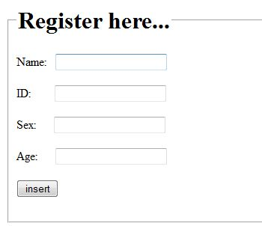
Insert.html (insert.php)
<html>
<body>
<fieldset>
<legend><h1>Register here...</h1></legend>
<form action="register.php" method="post">
Name: &nbsp; <input type="text" name="name"><br><br>
ID:&nbsp; &nbsp; &nbsp; &nbsp; <input type="text" name="id"><br><br>
Sex:&nbsp; &nbsp; &nbsp; <input type="text" name="sex"><br><br>
Age:&nbsp; &nbsp; &nbsp; <input type="text" name="age"><br><br>
<input type="submit" value="insert"><br><br>
</form>
</fieldset>
</body>
</html>

Slide 21
Register.php
<?php
$studname= mysqli_real_escape_string($con, $_POST['name']);
$age=mysqli_real_escape_string($con, $_POST['age']);
$sex=mysqli_real_escape_string($con, $_POST['sex']);
$sid=mysqli_real_escape_string($con, $_POST['id']);
$sql = "INSERT INTO student (StudName, age, sex, SID) VALUES ('$studname', '$age', '$sex', '$sid')";
if (!mysqli_query($con, $sql)) {
$err=1;
}
mysqli_close($con);
if(isset($err)){
header("location: index.html?err=1");
}
else{
header("location: index.html");
}
?>

Slide 22
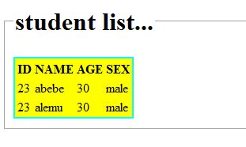
View.php
<?php require_once('connect_db.php')?>
<html>
<body>
<?php
$dbname="sampledb";
$con = connect_db($dbname);
$sql = "SELECT SID, StudName, age, sex FROM student";
$result=mysqli_query($con, $sql);
if(mysqli_num_rows($result)>0){
echo "<table border='1'><th>ID</th><th>NAME</th><th>AGE</th><th>SEX</th>";
while($row=mysqli_fetch_assoc($result)){
Echo"<tr><td>".$row["SID"]."</td><td>".$row["StudName"]."</td><td>".$row["age"]."</td><td>".$row["sex"]."</td></tr>";
}
echo "</table>";
}
else{
echo "no record found";
}
mysqli_close($con);
?>
</body></html>

Slide 23
Question
?

